Slide 1
Superpixel Classification
NeMo & NatureCoast
Bas Hoonhout & Max Radermacher, 12 December 2013

Slide 2
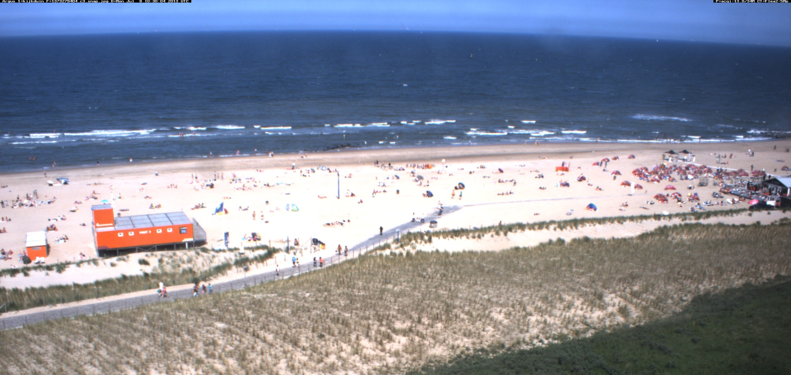
Introduction
Image Classification
What do we see if we look at an argus image?
Sea
Beach
Dunes
Notes:
What information do we use to classify these regions? A lot: shape, relative position, absolute position (when we have seen some Argus images before), color (something like HSV space), ‘texture’, …

Slide 3
Introduction
Image Classification
What can we do with it?
Notes:
Classification works in pixel space, but the results can easily be translated to x-y-space.
Shoreline mapper. By definition the interface between ‘beach’ and ‘sea’ is the shoreline. Elevation contour from tide + surge + wave set-up + wave run-up.
Intertidal beach detection. Potential source of sediment for aeolian transport.
Beach user detection. Pixels classified as beach users are mapped to x-y-space, yielding a surface area occupied by beach users. Establish a relation between surface and # of beach users (beach user density).
Two of these examples have already been applied in practice using highly specific detection algorithms. Superpixel classification is very general (can be applied for all methods) and is theoretically superior.
Probably many more applications, because it’s a very general method.

Slide 4
Superpixel Classification
Overview of the method
Segmentation (i.e. create superpixels)
Feature extraction Extract as much information as possible
Model construction and training Train a model which features characterize the classes
Model prediction Classify a new image
Notes:
What goes in is what comes out: the way you train the model, influences the predictions. Given the different purposes of classification (i.e. various tools), we want to settle on the best way to train.

Slide 5
1. Segmentation
Creating superpixels
Goal:
Clustering individual pixels, with similar intrinsic features, into n superpixels
Intrinsic features are related to:
Pixel intensity
Value
Spatial gradient
Statistics of intensity (mean, variance, min, max)
Position (in m,n space)

Slide 6
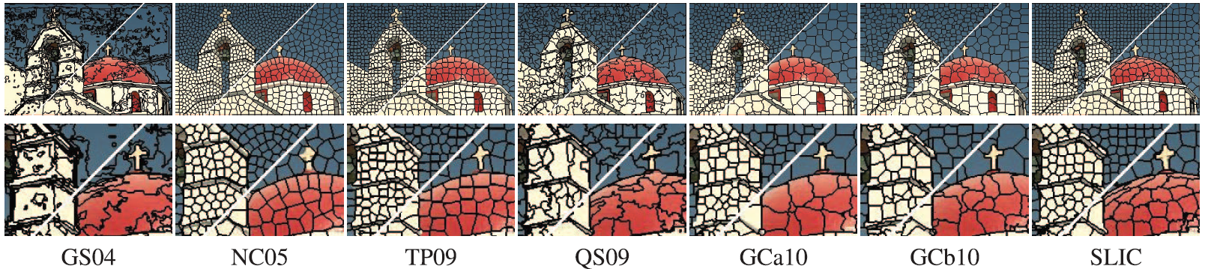
1. Segmentation
Various algorithms available
N points are seeded in a regular grid
Around every grid point, pixels with similar features are sought
Free parameters:
Number of superpixels to create
Compactness (importance of Intensity vs. Position)
Notes:
Point out the differences in behaviour. This becomes clear in each lower right side of the figures: the way the cross is incorporated.

Slide 7
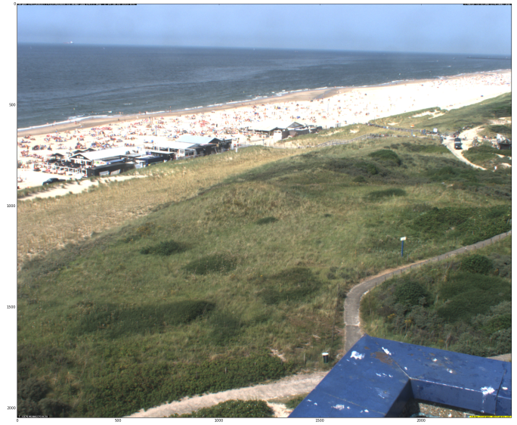
1. Segmentation
Application to a Kijkduin image

Slide 8
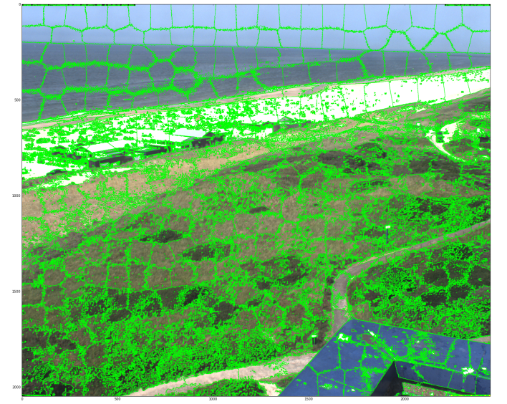
1. Segmentation
Application to a Kijkduin image

Slide 9
2. Feature extraction
Compute training data
Extract as much information about the superpixels as possible:
Intrinsic features
Extracted features, e.g.:
Area
Area of convex hull
Holeyness
Shape
…

Slide 10
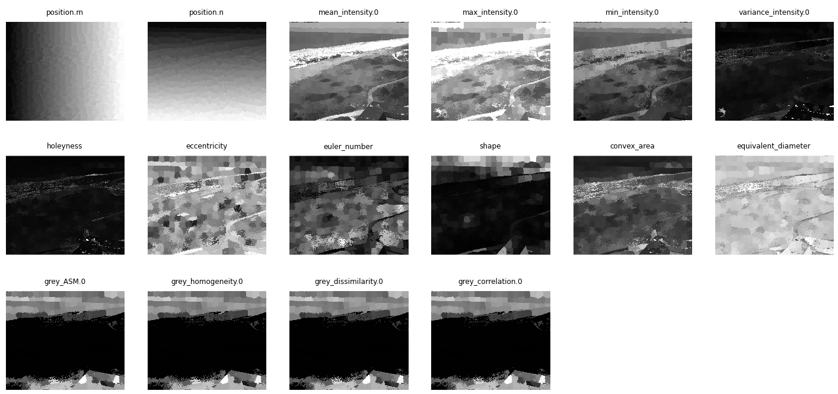
2. Feature extraction
Compute training data

Slide 11
3. Model construction and training
Conditional Random Fields (CRF)
A Conditional Random Field (CRF) is a type of Probabilistic Graphical Model (PGM)
A PGM is a graphical representation of a joint probability distribution:

Slide 12
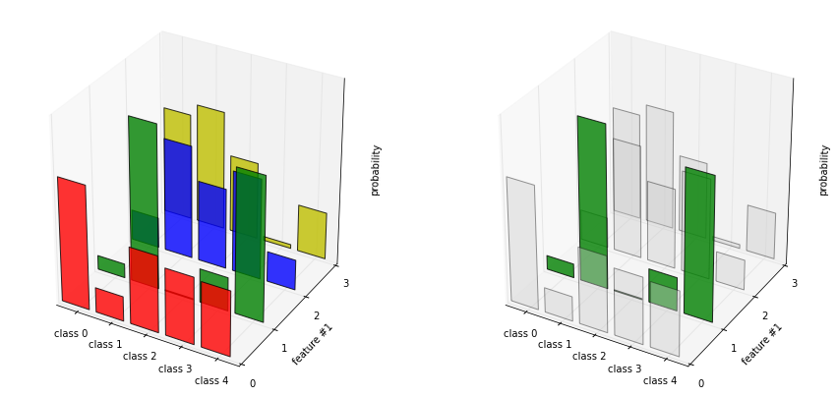
3. Model construction and training
Conditional Random Fields (CRF)
Class associated with superpixel
Vector with features associated with superpixel

Slide 13
3. Model construction and training
All superpixels share the same joint probability distribution
Conditional Random Fields (CRF)
Probability distribution of a single feature
f₁
f₂
f₃
…
f_{K}
C
Probability distribution for single superpixel over all classes and all possible states of feature vector

Slide 14
3. Model construction and training
Class assignments only depend on features not on other superpixels
Conditional Random Fields (CRF)
f₁
…
f_{K}
f₁
…
f_{K}
f₁
…
f_{K}
C₀₀
…
C_{0M}
A single joint probability distribution is associated with each superpixel in a regular grid
f₁
…
f_{K}
f₁
…
f_{K}
f₁
…
f_{K}
…
…
…
f₁
…
f_{K}
f₁
…
f_{K}
f₁
…
f_{K}
C_{N0}
…
C_{NM}

Slide 15

3. Model construction and training
Conditional Random Fields (CRF)
f₁
…
f_{K}
f₁
…
f_{K}
f₁
…
f_{K}
Now the probability distribution for each superpixel over all classes and features also depends on class assignments of neighboring superpixels
C₀₀
…
C_{0M}
f₁
…
f_{K}
f₁
…
f_{K}
f₁
…
f_{K}
…
…
…
f₁
…
f_{K}
f₁
…
f_{K}
f₁
…
f_{K}
C_{N0}
…
C_{NM}

Slide 16
3. Model construction and training
A potential is a dependent node without probability distribution that penalizes differences between adjacent superpixel assignments
Conditional Random Fields (CRF)
f₁
…
f_{K}
f₁
…
f_{K}
f₁
…
f_{K}
C₀₀
Ψ
…
Ψ
C_{0M}
A potential node is added between adjacent superpixels limiting the dimensionality of the joint probability distribution
f₁
Ψ
…
f_{K}
f₁
…
…
f_{K}
f₁
Ψ
…
f_{K}
…
…
…
…
…
f₁
Ψ
…
f_{K}
f₁
...
…
f_{K}
f₁
Ψ
…
f_{K}
C_{N0}
Ψ
…
Ψ
C_{NM}

Slide 17
3. Model construction and training
Conditional Random Fields (CRF)
Class associated with superpixel
Vector with features associated with superpixel
Pairwise potentials associated with neighboring superpixels

Slide 18
3. Model construction and training
Conditional Random Fields (CRF)
So we can read the thing we are interested in?
How do we determine this thing?
Model training

Slide 19
3. Model construction and training
Conditional Random Fields (CRF)
A Conditional Random Field (CRF) is a type of Probabilistic Graphical Model (PGM)
A PGM is trained based on Bayes’ Rule for conditional probabilities:

Slide 20
3. Model construction and training
Conditional Random Fields (CRF)
This is the thing we are interested in:
it gives the probability of each class to be associated with a superpixel given all features of that superpixel
Counting classes
A-priori probability distribution over classes
A-priori probability distribution over feature values
Counting features

Slide 21
3. Model construction and training
Conditional Random Fields (CRF)
This is the thing we are interested in:
it gives the probability of each class to be associated with a superpixel given all features of that superpixel
Counting features per class
Counting classes
Probability distribution over feature values given the class of the superpixel
A-priori probability distribution over classes
We need feature values that are associated with a pre-determined number of classes
➔
We need manually classified images!
A-priori probability distribution over feature values
Counting features

Slide 22
3. Model construction and training
Conditional Random Fields (CRF)
Now we can extract the conditional probability distribution from manually classified images:
An iterative optimization algorithm can subsequently provide us with the largest joint probability and hence the most probable classification of the image:

Slide 23
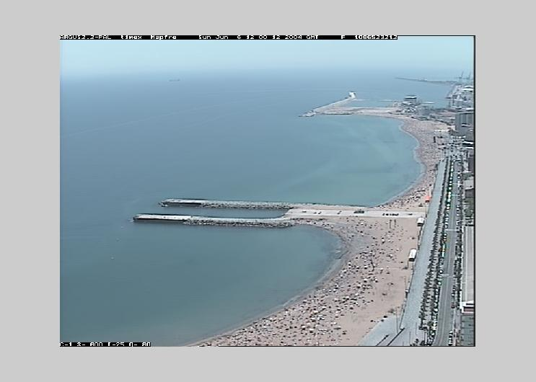
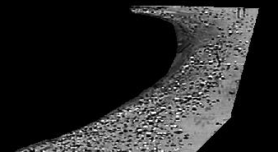

3. Model construction and training
Dimensionality
Example: beach user detection algorithm

Slide 24
3. Model construction and training
Dimensionality
1-dimensional discrimination
Threshold set by manual calibration
Pixel intensity
0
Object
Beach

Slide 25
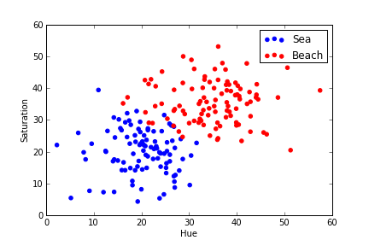
3. Model construction and training
Dimensionality
Example: shoreline mapping

Slide 26
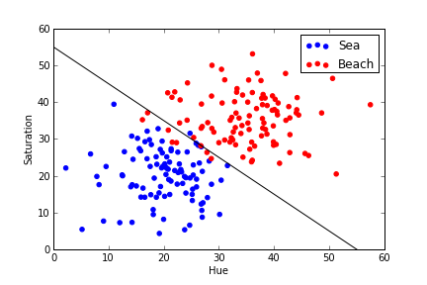
3. Model construction and training
Dimensionality
Example: shoreline mapping

Slide 27
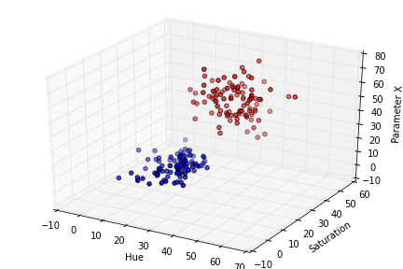
3. Model construction and training
Dimensionality
Example: shoreline mapping

Slide 28
3. Model construction and training
Dimensionality
What about superpixel classification?
Every feature adds a dimension
The analysis is 50-70 dimensional!
Segmentation has yielded many additional features to examine

Slide 29
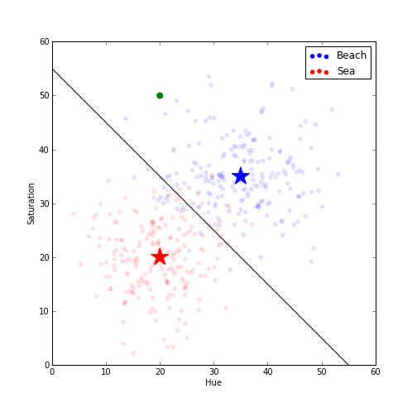
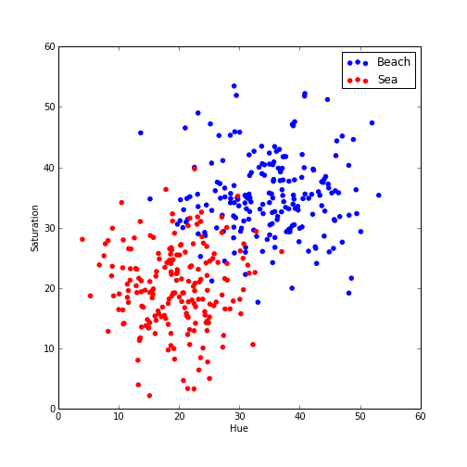
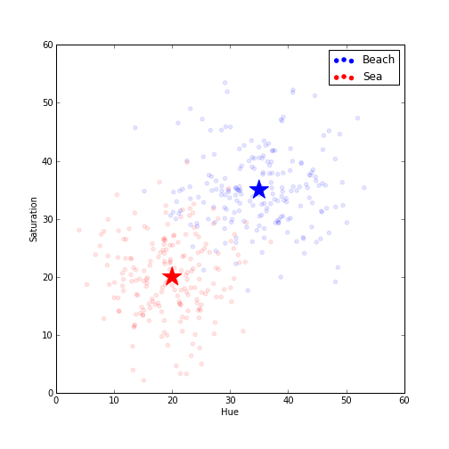
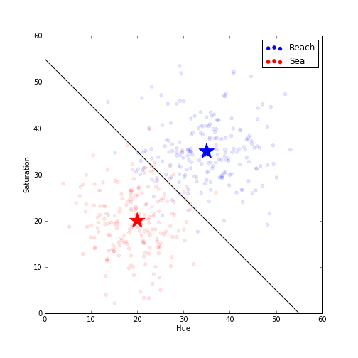
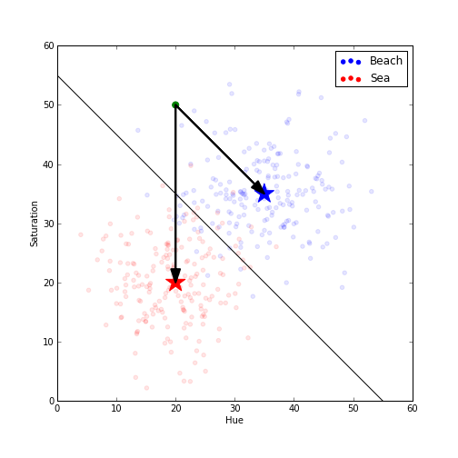
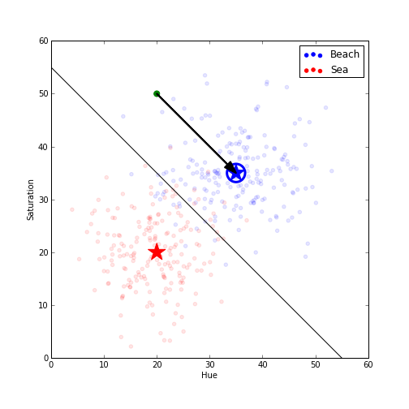
4. Model prediction
Classify a new image
Evaluate the n-dimensional classification space for the new feature values:

Slide 30

Training dataset
This is confusing!
Issues
Training is a trade-off:
Having a lot of classes leads to small differences between classes
Dunefoot vs. beach
Intertidal beach vs. dry beach
Having too few classes does not provide enough detail
If you only classify ‘off-shore’ and ‘onshore’, you cannot compute the surface of the beach, or detect beach users

Slide 31
Training dataset
Solution
Being very strict in the way you classify (no ambiguity)
Defining an optimal amount of classes
Introducing a two-step method
Coarse classification: sky, sea, beach, dune, objects (, labels)
Fine classification: Beach = {people, intertidal, …} Dune ={sand, vegetation, pathway} …

